Slide 1
BRIDGE SOFTWARE ENGINEER (BrSE)
IT BUSINESS ANALYST (IT BA)
AND
SWR302 - Group 1

Slide 2
TEAM MEMBERS

Slide 3
TEAM MEMBERS
Hoang Thi Hoai Thuong
Student code: SE140087
Vo Nguyen Hoang
Student code: SE130308
Phan Nhat Truong
Student code: SE140413
Nguyen Hung Hai
Student code: SE141104
Le Minh Khoi
Student code: SE140763

Slide 4
AGENDA
DIFFERENCES
1
2
3
INTRODUCTION
SIMILARITIES
4
5
SUMMARY
Q & A

Slide 5
01
INTRODUCTION

Slide 6
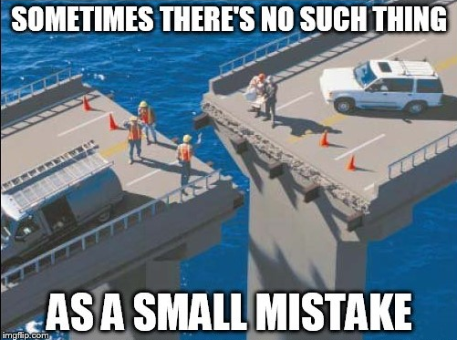
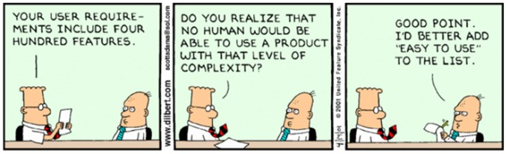

Slide 7
What is IT-BA ?

Slide 8
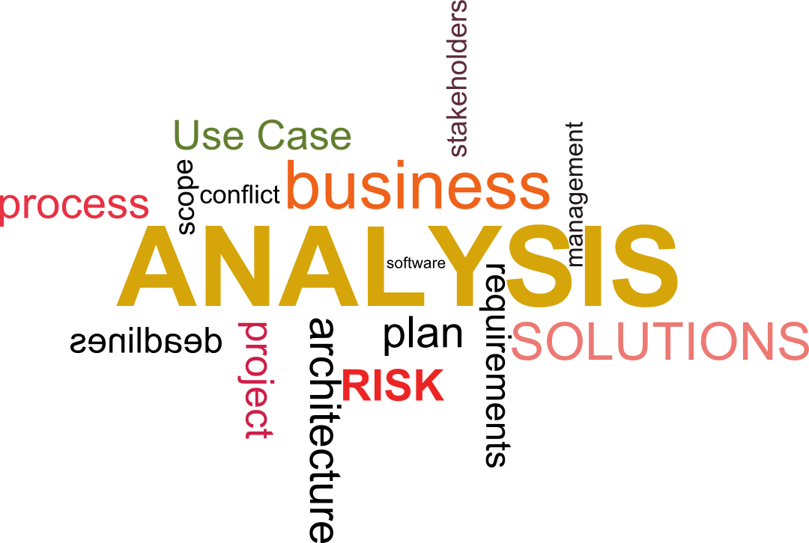

Slide 9
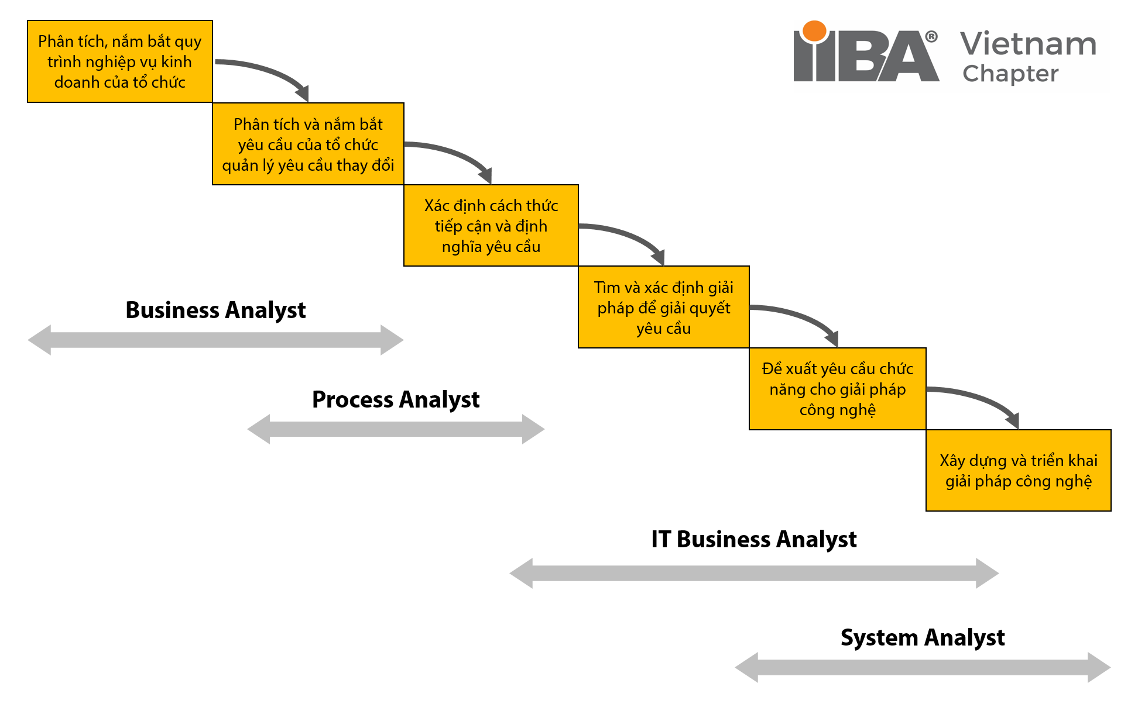

Slide 10
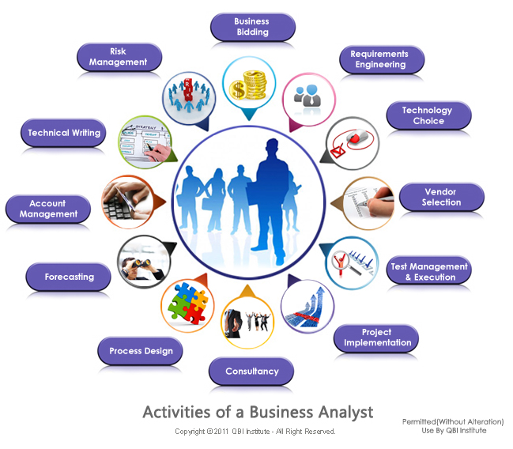
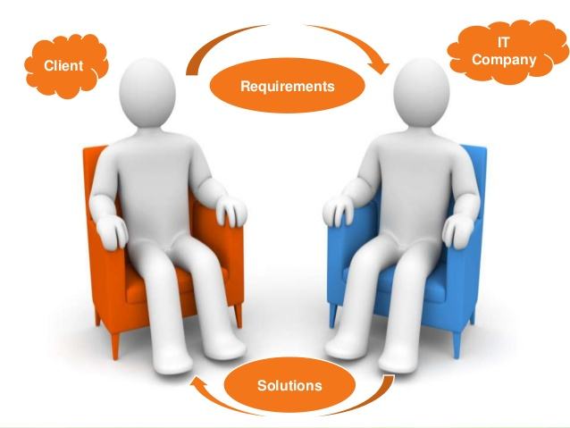

Slide 11
What is BrSE ?

Slide 12


Slide 13
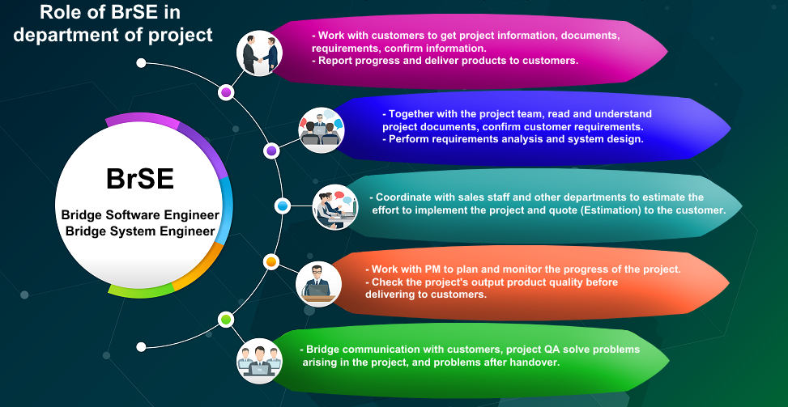

Slide 14
02
SIMILARITIES

Slide 15
SIMILARITIES
Concept:
Both are related to IT.
They serve as the principal interpreter through which requirements flow between the customer community and the software development team.

Slide 16
SIMILARITIES
Focus:
Both jobs involve requirements engineering.
Enable change in an organizational context and recommending solutions that deliver value to stakeholders.

Slide 17
SIMILARITIES
Focus:
Both of them work with the development team, customers and the project manager
Both prioritize resolving conflicts between involved parties
Priority:

Slide 18
SIMILARITIES
Both require some similar soft skills:
Listening skills
Interviewing and questioning skills
Thinking on your feet
Analytical thinking
System thinking skills
Learning skills

Slide 19
SIMILARITIES
Both require some similar soft skills:
Facilitation skills
Leadership skills
Observation skills
Communication skills
Organizational skills
Modeling skills
Interpersonal skills
Creativity

Slide 20
SIMILARITIES
Both IT BA and BrSE face the same challenges:
Great amount of work
Cultural differences
They involved throughout the entire software development life cycle

Slide 21
SIMILARITIES
Should not expect a specific educational background:
It is not necessary to have an IT background as long as they have a general understanding of how systems, products, and tools work
Having a strong background in IT is a big chance
Some may have a strong IT background and less experience in business and are interested in shifting away from IT to this hybrid role.

Slide 22
SIMILARITIES
Both IT BAs and BrSEs face the same challenges:
Great amount of work
Cultural differences

Slide 23
SIMILARITIES
Knowledge:
Understand requirement engineering
Understand SDLC (Software Development Life Cycle) and other software methodologies (including Agile, requirements gathering, elicitation, modeling, prototyping) (optional but recommended)
Product management concepts, basic knowledge about the architecture and operating environment.
Understand of project management

Slide 24
02
DIFFERENCES

Slide 25
DIFFERENCES
Concept:
IT BUSINESS ANALYST
BRIDGE SOFTWARE ENGINEER
IT BA is short for Information technology business analyst
IT BA is a project role, not necessarily a job title
BrSE is short for Bridge Software Engineer
BrSE is a job title

Slide 26
DIFFERENCES
Focus:
IT BUSINESS ANALYST
BRIDGE SOFTWARE ENGINEER
The BA is the individual who has the primary responsibility to elicit, analyze, document, and validate the needs of the project stakeholders.
The main aim of a BrSE is to understand the customers’ requirements and convey them to the development team. A BrSE also has to make sure that the customers get the solutions, progress from the development team.

Slide 27
DIFFERENCES
IT BUSINESS ANALYST
BRIDGE SOFTWARE ENGINEER
The business analyst position requires both hard skills and soft skills.
Knowing how to pull, analyze and report data trends
Knowing business structure
Being detail-oriented and capable of delivering a high level of accuracy
Costs benefit analysis
Stakeholder analysis
Soft skills:
Foreign languages are compulsory
In addition to IT skills, Bridge SE requires people who are familiar with the languages, cultures and business practices of both countries
Ability to lead a team, assign the tasks for members, and work in group

Slide 28
DIFFERENCES
IT BUSINESS ANALYST
BRIDGE SOFTWARE ENGINEER
Key responsibilities:
Identify, prioritize technical and functional requirements, get feedback and approval on requirements
Have a strong mindset to deal with technical aspects of the application and work closely with the stakeholder to help them out during product development. Provide valuable suggestions to the customer in order to make their business grow
Key responsibilities:
Answer any question from the development team and the customers
Keep track of the working progress and problems that may arise along the way
Guarantee the product’s quality and punctuality
Convey the customers’ need to the development team accurately
Make sure the communication between the two sides go smoothly

Slide 29
DIFFERENCES
IT BUSINESS ANALYST
BRIDGE SOFTWARE ENGINEER
Key responsibilities:
Bridge the gap between IT and the business using data analytics to assess processes, determine requirements and deliver data-driven recommendations and reports to executives and stakeholders.
Create new models that support business decisions by working closely with financial reporting and IT teams to establish initiatives and strategies to improve importing and to optimize costs.
Key responsibilities:
Answer any question from the development team and the customers.
Keep track of the working progress and problems that may arise along the way.
Guarantee the product’s quality and punctuality
Convey the customers’ need to the development team accurately
Make sure the communication between the two sides go smoothly

Slide 30
DIFFERENCES
IT BUSINESS ANALYST
BRIDGE SOFTWARE ENGINEER
Key responsibilities:
Engaging with business leaders and users to understand how data-driven changes to process, products, services, software and hardware can improve efficiencies and add value. They must articulate those ideas but also balance them against what’s technologically feasible and financially and functionally reasonable. Depending on the role, you might work with data sets to improve products, hardware, tools, software, services or process.
Key responsibilities:
Answer any question from the development team and the customers.
Keep track of the working progress and problems that may arise along the way.
Guarantee the product’s quality and punctuality
Convey the customers’ need to the development team accurately
Make sure the communication between the two sides go smoothly

Slide 31
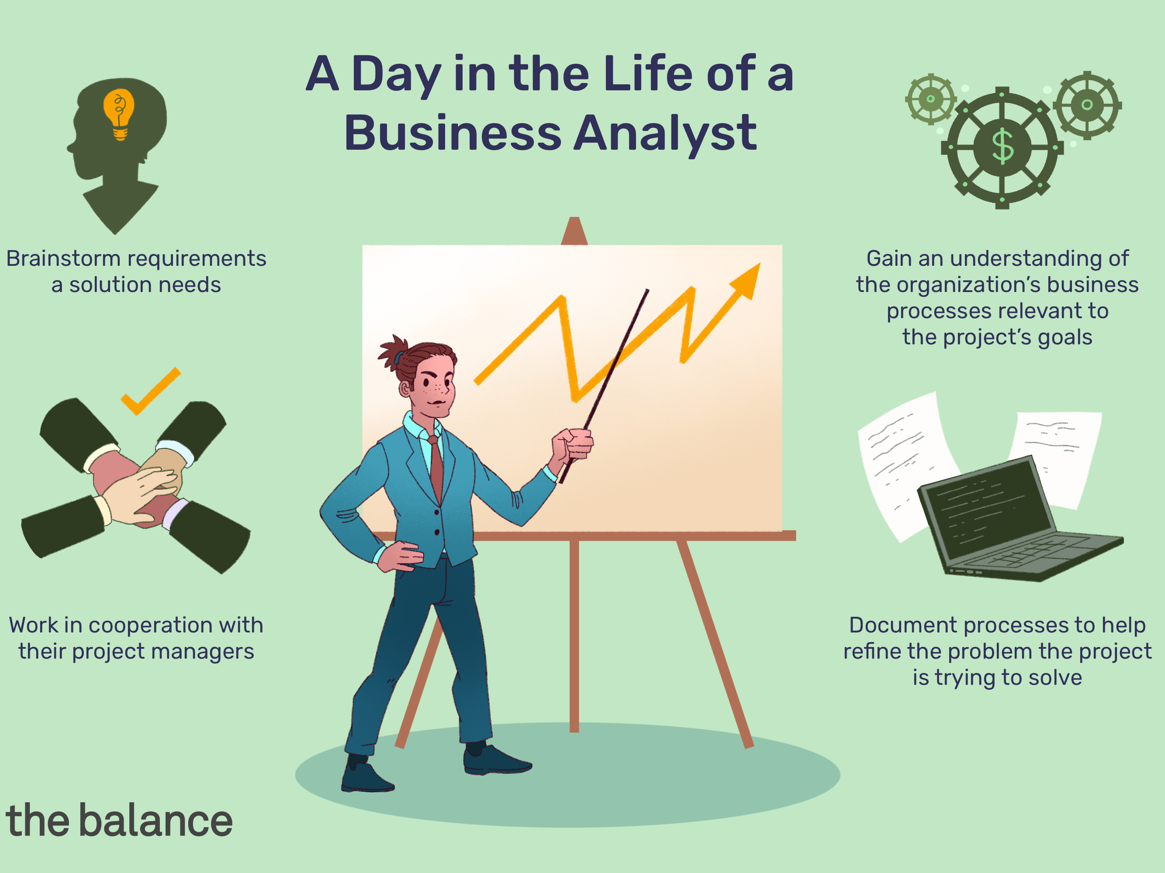

DIFFERENCES
IT BUSINESS ANALYST
BRIDGE SOFTWARE ENGINEER

Slide 32
DIFFERENCES
IT BUSINESS ANALYST
BRIDGE SOFTWARE ENGINEER
Tasks:
Creating a detailed business analysis, outlining problems, needs, opportunities, and solutions for a business
Consulting with executives and the IT department about the newest technology and its implications in the industry.
Budgeting and forecasting
Planning and monitoring
Reporting
Tasks:
Accurately conveying the needs of the customers and coordinate how to proceed
Encouraging communication between the dev team and the customers
Preparing design documents for offshore use
Exchanging email with customers, negotiating with them
Connecting business chances between both sites

Slide 33
DIFFERENCES
IT BUSINESS ANALYST
BRIDGE SOFTWARE ENGINEER
Tasks:
Defining business requirements and reporting them back to stakeholders
Consulting with executives and the IT department about the newest technology and its implications in the industry.
Assuming responsibility for project tasks and ensuring they are completed in a timely fashion.
Tasks:
Project management (development content, delivery date,etc.)
Joining the development team to code (if neccessary)
Checking the product before delivery
Setting up and facilitating meetings
If any bug is found by the customers, find a way to fix them

Slide 34
DIFFERENCES
IT BUSINESS ANALYST
BRIDGE SOFTWARE ENGINEER
Workplace:
Workplace:
They can work in many companies that work with IT
They also work with executives, stakeholders, financial reporting and IT teams, business leader, quality assurance teams
BrSE is a job that is unique to outsourcing companies
Collaborator:

Slide 35
DIFFERENCES
Priority:
IT BUSINESS ANALYST
BRIDGE SOFTWARE ENGINEER
An IT BA’s priority is balancing benefits between stakeholders; technological feasibility, financial and functional reasonability
A BrSE’s priority is to come up with solutions which are most suitable for both sides

Slide 36
DIFFERENCES
IT BUSINESS ANALYST
BRIDGE SOFTWARE ENGINEER
Knowledge:
Understand contemporary requirements engineering practices and how to apply them in the context SDLC
Thread requirements development and management activities
Understand risk management, and quality engineering
Knowledge:
Understanding of customers’ cultures
Accurate documents translation techniques

Slide 37
03
SUMMARY

Slide 38
04
Q & A

Slide 39
References
https://itguru.vn/blog/15-cau-hoi-thu-vi-ve-ky-su-cau-noi-bridge-system-engineer/#2Bridge_Software_Engineer_hay_Bridge_System_Engineer
https://www.cio.com/article/276798/project-management-what-do-business-analysts-actually-do-for-software-implementation-projects.html
https://relipasoft.com/blog/what-is-bridge-se/#SE-5
https://www.indeed.com/career-advice/careers/what-does-an-it-business-analyst-do
.....

Slide 40
THANKS

